Slide 1
Blacktown Chinese Christian Church
Welcome to Our English Service 03.08.2025
English Service 9:45 – 11:00 am
Worship Songs: Passage: Speaker: Topic: Response Song: Announcements and Closing Prayer Benediction
Thrive King of kings Living hope Jose Peter Ezekiel TBA

Slide 2
BCCC english service

Slide 3

Please keep all phones on silent

Slide 4
Thrive
CCLI Licence No: 5485849

Slide 5
Here in this worn and weary land
Where many a dream has died
Like a tree planted by the water
We never will run dry

Slide 6
So living water flowing through
God we thirst for more of You
Fill our hearts and flood our souls
With one desire

Slide 7
Just to know You and
To make You known
We lift Your name on High
Shine like the sun make darkness run and hide

Slide 8
We know we were made for so much more
Than ordinary lives
It's time for us to more than just survive
We were made to thrive

Slide 9
Into Your word we're digging deep
To know our Father's heart
Into the world we're reaching out
To show them who You are

Slide 10
So living water flowing through
God we thirst for more of You
Fill our hearts and flood our souls
With one desire

Slide 11
Just to know You and
To make You known
We lift Your name on High
Shine like the sun make darkness run and hide

Slide 12
We know we were made for so much more
Than ordinary lives
It's time for us to more than just survive
We were made to thrive

Slide 13
Joy Unspeakable, Faith Unsinkable
Love Unstoppable, Anything is possible
Joy Unspeakable, Faith Unsinkable
Love Unstoppable, Anything is possible (x2)

Slide 14
Just to know You and
To make You known
We lift Your name on High
Shine like the sun make darkness run and hide

Slide 15
We know we were made for so much more
Than ordinary lives
It's time for us to more than just survive
We were made to thrive

Slide 16
We were made to thrive

Slide 17
King Of Kings
CCLI Licence No: 5485849

Slide 18
In the darkness we were waiting
Without hope, without light
Till from heaven You came running
There was mercy in Your eyes

Slide 19
To fulfill the law and prophets
To a virgin came the word
From a throne of endless glory
To a cradle in the dirt

Slide 20
Praise the Father, praise the Son
Praise the Spirit, three in one
God of glory, Majesty
Praise forever to the King of Kings

Slide 21
To reveal the kingdom coming
And to reconcile the lost
To redeem the whole creation
You did not despise the cross

Slide 22
For even in your suffering
You saw to the other side
Knowing this was our salvation
Jesus for our sake you died

Slide 23
Praise the Father, praise the Son
Praise the Spirit, three in one
God of glory, Majesty
Praise forever to the King of Kings

Slide 24
And the morning that You rose
All of heaven held its breath
Till that stone was moved for good
For the Lamb had conquered death

Slide 25
And the dead rose from their tombs
And the angels stood in awe
For the souls of all who'd come
To the Father are restored

Slide 26
And the Church of Christ was born
Then the Spirit lit the flame
Now this gospel truth of old
Shall not kneel, shall not faint

Slide 27
By His blood and in His name
In His freedom I am free
For the love of Jesus Christ
Who has resurrected me

Slide 28
Praise the Father, praise the Son
Praise the Spirit, three in one
God of glory, Majesty
Praise forever to the King of Kings

Slide 29
Praise forever to the King of Kings

Slide 30
Living Hope
CCLI Licence No: 5485849

Slide 31
How great the chasm that lay between us
How high the mountain I could not climb
In desperation, I turned to heaven
And spoke Your name into the night

Slide 32
Then through the darkness, Your loving kindness
Tore through the shadows of my soul
The work is ﬁnished, the end is written
Jesus Christ, my living hope

Slide 33
Who could imagine so great a mercy?
What heart could fathom such boundless grace?
The God of ages stepped down from glory
To wear my sin and bear my shame

Slide 34
The cross has spoken, I am forgiven
The King of Kings calls me His own
Beautiful Savior, I'm Yours forever
Jesus Christ, my living hope

Slide 35
Hallelujah, praise the One who set me free
Hallelujah, death has lost its grip on me

Slide 36
You have broken every chain
There's salvation in Your name
Jesus Christ, my living hope

Slide 37
Hallelujah, praise the One who set me free
Hallelujah, death has lost its grip on me

Slide 38
You have broken every chain
There's salvation in Your name
Jesus Christ, my living hope

Slide 39
Then came the morning that sealed the promise
Your buried body began to breathe
Out of the silence, the Roaring Lion
Declared the grave has no claim on me (x2)

Slide 40
Jesus, Yours is the victory

Slide 41
Hallelujah, praise the One who set me free
Hallelujah, death has lost its grip on me

Slide 42
You have broken every chain
There's salvation in Your name
Jesus Christ, my living hope

Slide 43
Hallelujah, praise the One who set me free
Hallelujah, death has lost its grip on me

Slide 44
You have broken every chain
There's salvation in Your name
Jesus Christ, my living hope

Slide 45
Jesus Christ, my living hope
Oh God, You are my living hope

Slide 46
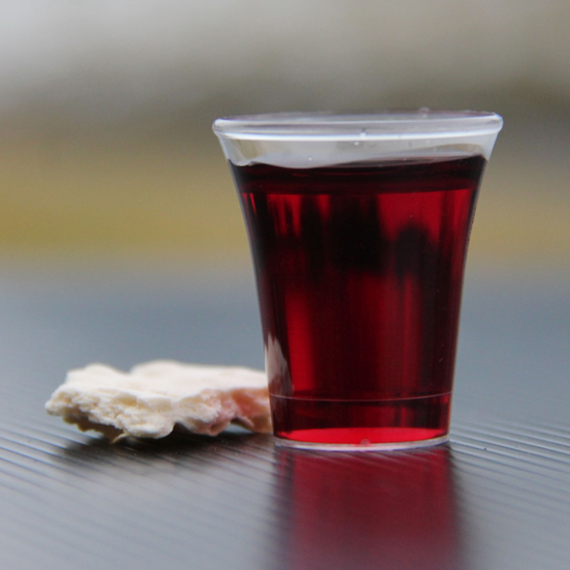
Holy Communion

Slide 47
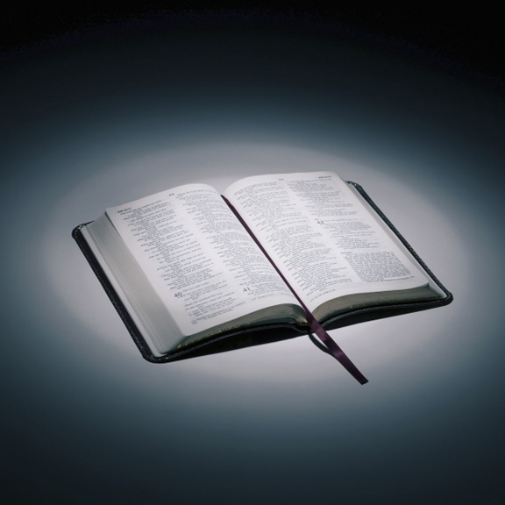
Bible reading

Slide 48
T

Slide 49
T

Slide 50
Announcements

Slide 51





Account name: Blacktown Chinese Christian Church
Account number: 4216 50263
Offering
BSB: 112 - 879
Please put in "offering" as the reference
The offering box is available at the back of the hall

Slide 52
Prayer points

Slide 53
Mingle time!

